Slide 1
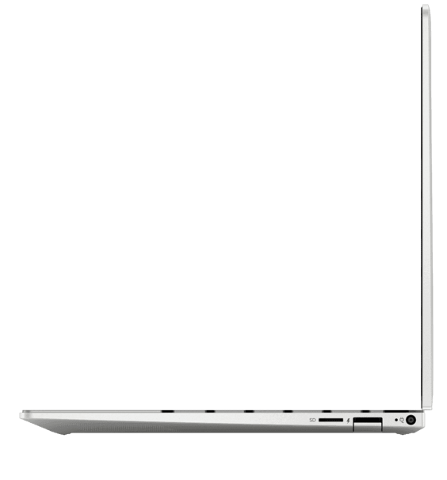
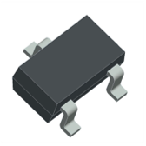
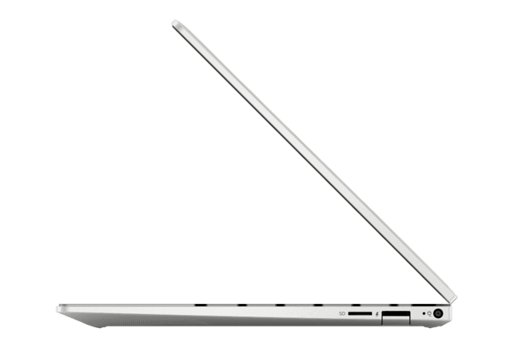
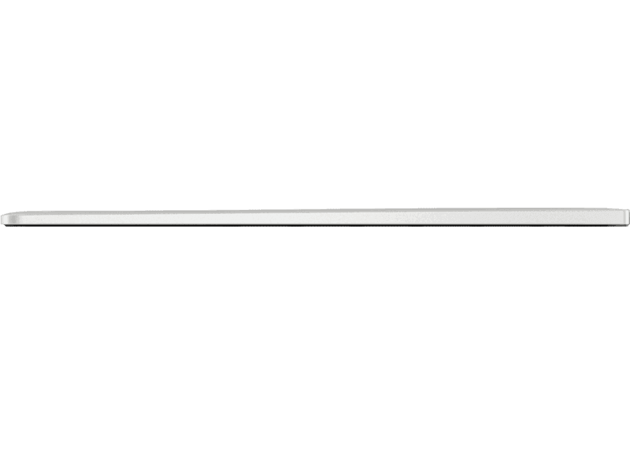
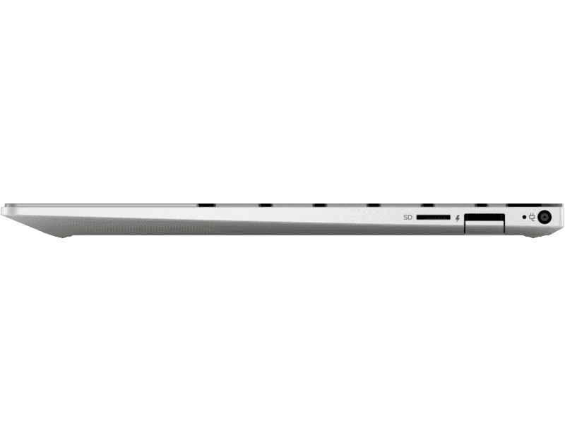
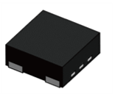

MH49X Ratio Metric Linear Hall
Microphone function by multiple Screen opening Angle
Microphone
Part Number | Sensitivity | Note
MH491 | 1.5mV/G | CMOS Ratio-Metric Linear Hall Effect IC
 | 2mV/G
 | 2.5mV/G
 | 3mV/G
MH492 | 5mV/G | CMOS Ratio-Metric Linear Hall Effect IC
 | 9mV/G
MH493 | 4mV/G | CMOS Ratio-Metric Linear Hall Effect IC
 | 7mV/G
 | 10mV/G
 | 13mV/G
90°
Microphone
2.9*1.6*1.1 (mm)
45°
0°
2.0*2.0*0.6 (mm)
PAGE 01

